Slide 1
SOLAR POWER MOINTORING using IOT
Team Details
M.SRIRAM (20EG105714)
K.HARSHAVARDHAN (20EG105703)
G.MOKSHITHA (20EG105116)
K.ARYAN (20EG105126)
Project Supervisor
V. JYOTHI
Assistant Professor

Slide 2
Introduction
An IoT-based solar power monitoring system is a setup that utilizes Internet of Things (IoT) technology to monitor and manage solar power generation and consumption in real-time.
This system typically requires solar panels equipped with sensors to measure power generation, IoT devices to transmit data to a central monitoring system, and a software platform for data analysis and visualization .
Such systems find applications in various sectors including residential, commercial, and industrial settings. They enable efficient monitoring of solar power generation, optimize energy consumption, and facilitate remote management of solar power systems.

Slide 3
Problem Statement
Traditional solar power monitoring systems often lack real-time monitoring capabilities and remote management features, leading to inefficient utilization of solar energy. Without timely access to critical data regarding power generation and consumption, operators are unable to make informed decisions to optimize the performance of solar power systems. This results in suboptimal energy production, increased operational costs, and missed opportunities for energy savings. To address this, an IoT-based solar power monitoring system becomes imperative. By deploying a network of sensors on solar panels, capable of relaying data to a central server, this proposed solution seeks to revolutionize the monitoring paradigm.

Slide 4
Proposed Method
The proposed method involves deploying IoT-enabled sensors on solar panels to continuously monitor parameters like power output, temperature, and sunlight intensity. Data collected from these sensors is transmitted wirelessly to a central monitoring system through IoT communication protocols.

Slide 5
Proposed Method Illustration
1. Sensor Deployment: Strategically place sensors on solar panels to capture and measure critical parameters including voltage, current, temperature, and sunlight intensity.
2. IOT Devices: Connect these sensors to IoT devices, such as microcontrollers, capable of processing and transmitting the collected data.
3. Data Transmission: Utilize wireless communication protocols such as HTTP to establish a seamless flow of data from IoT devices to a central server.

Slide 6
Proposed Method Illustration
4. Central Server: Establish a dedicated server to receive, store, and process the incoming data. This server serves as the central hub for monitoring and managing the solar power system.
5. Data Analysis: Implement sophisticated algorithms to analyze the collected data, extracting insights into energy production, system efficiency, and environmental conditions.
6. User Interface: Develop a user-friendly interface, either in the form of a web application or mobile app, enabling users to monitor the solar power system in real-time. This interface should also facilitate historical data analysis and provide timely notifications.

Slide 7
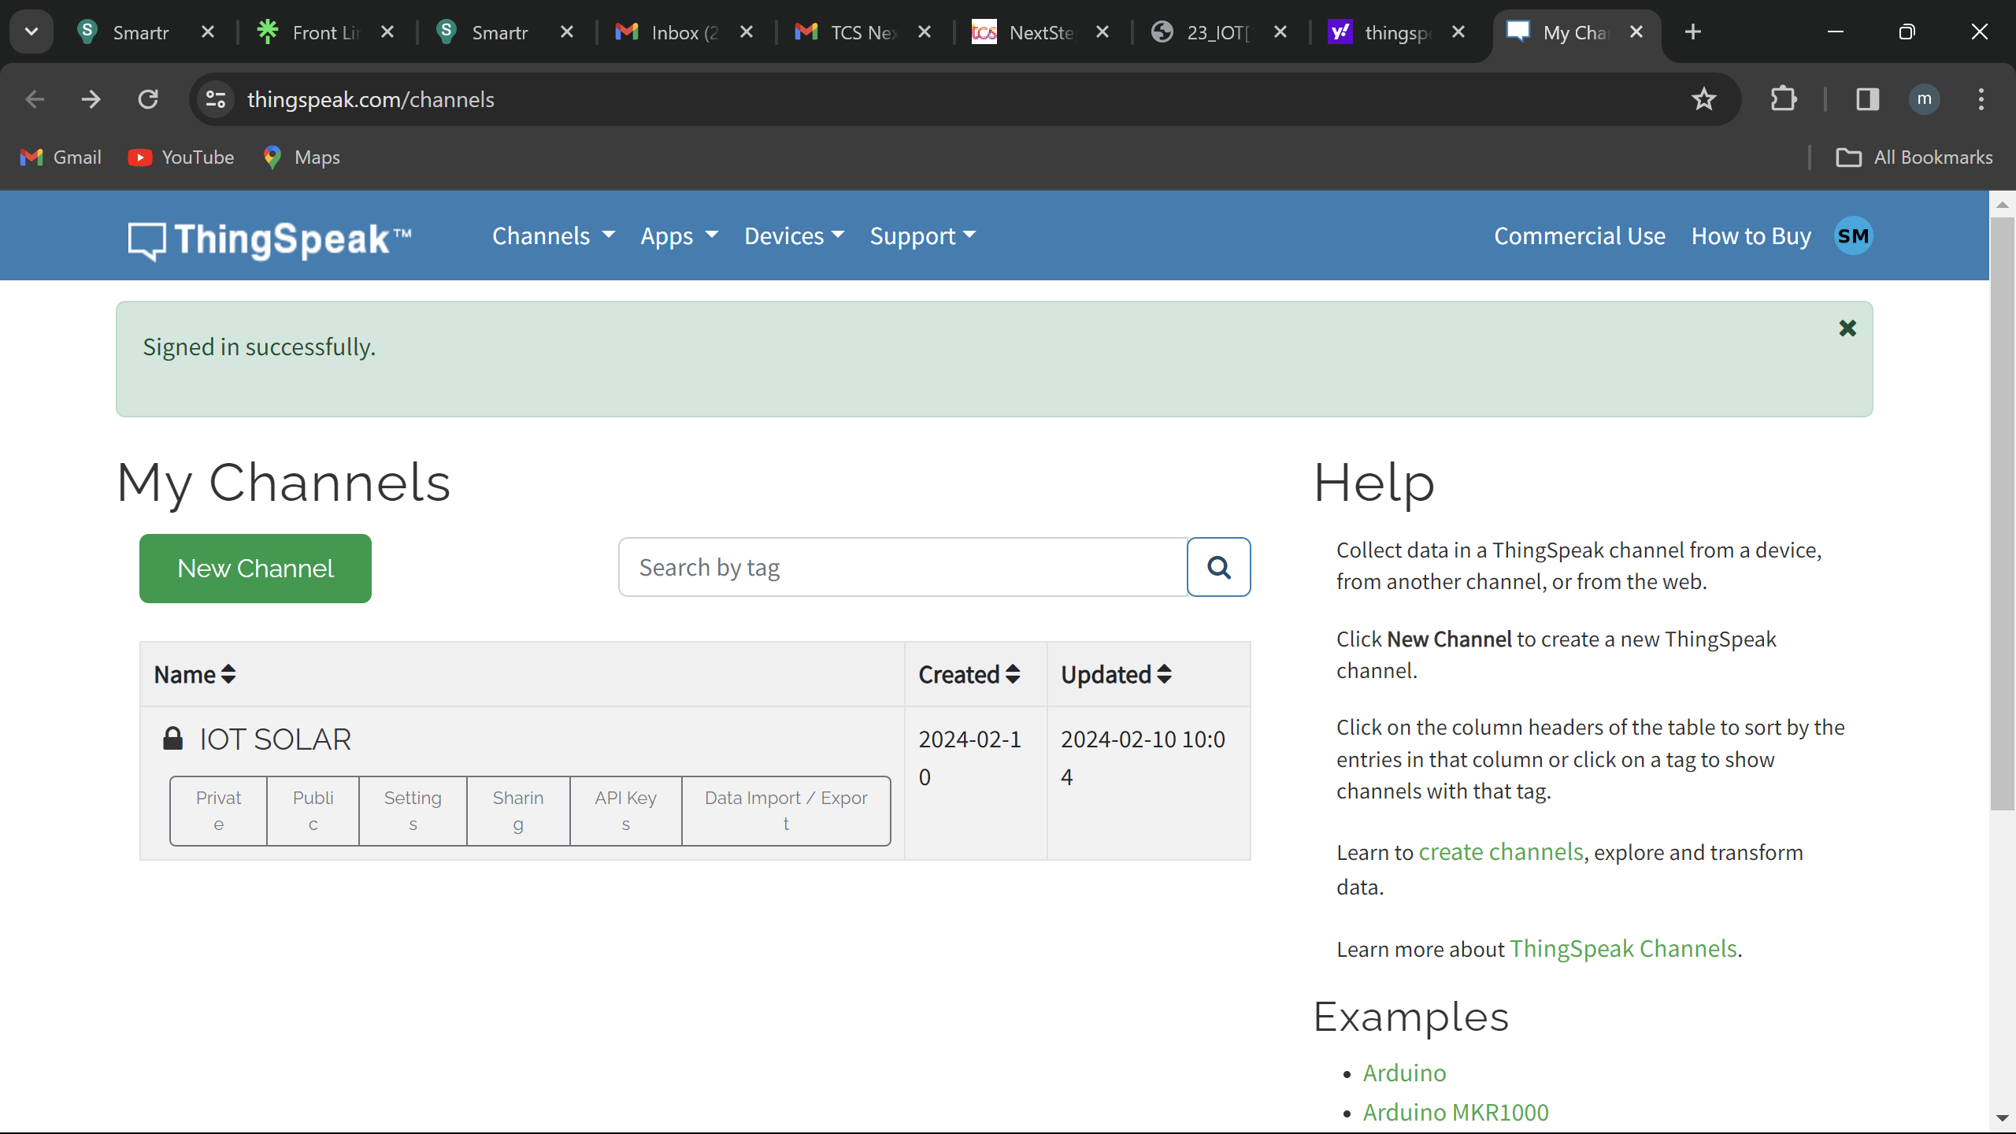
Experiment Screen shorts

Slide 8
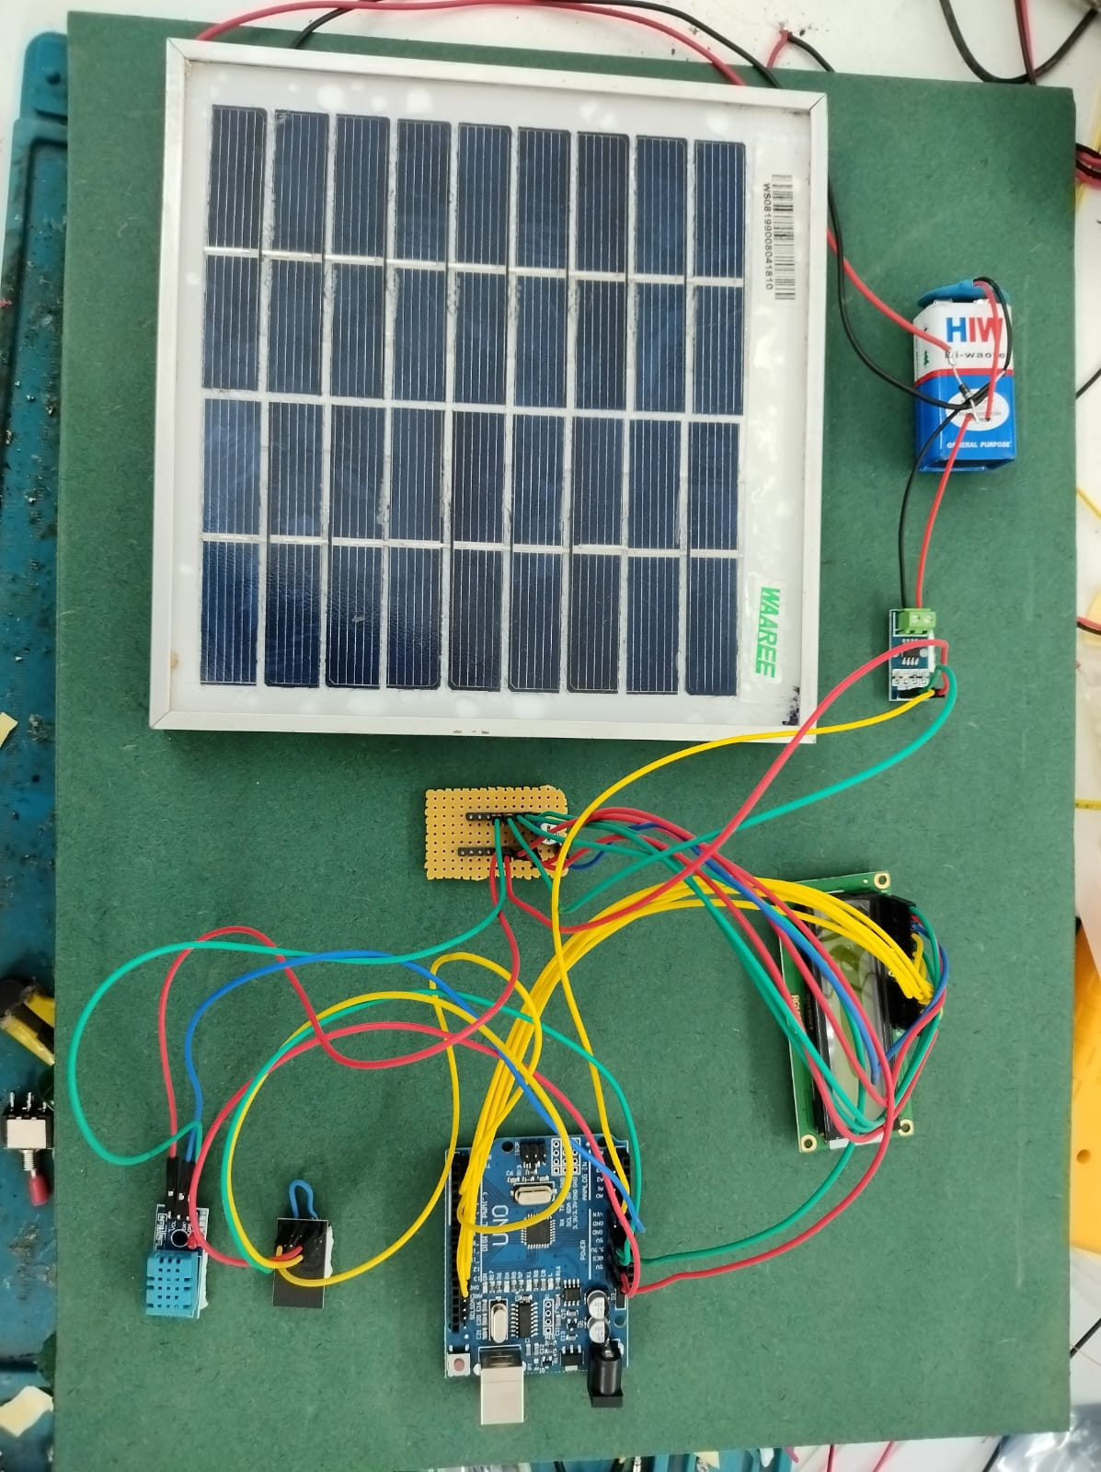
Experiment Screen shorts

Slide 9
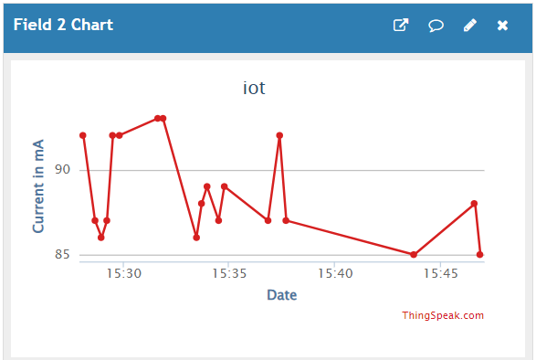
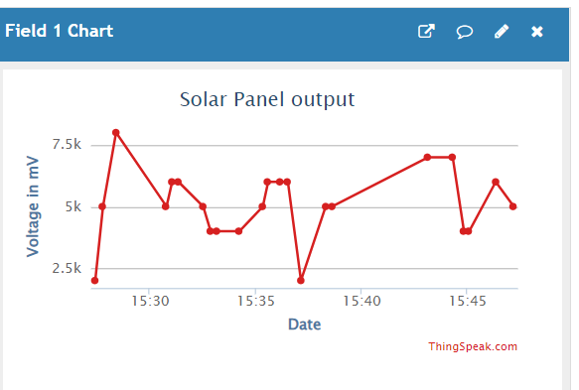
Experiment Screen shorts

Slide 10
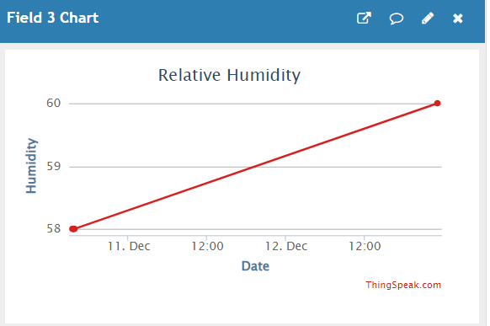
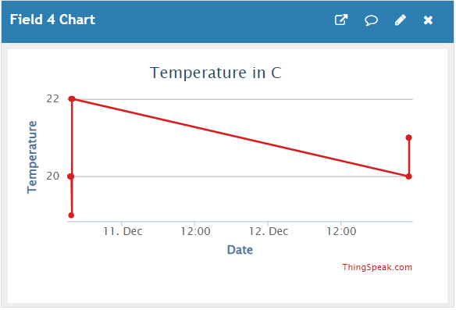
Experiment Screen shorts

Slide 11
Experiment Results
Remote Monitoring and Analysis: One of the biggest advantages is remote monitoring capability. Users can access data and system health from anywhere with an internet connection. This eliminates the need for frequent physical visits to the solar panel location.
Fault Detection and Predictive Maintenance: By analyzing the collected data, the system can detect anomalies or gradual performance decline. This allows for preventive maintenance before major failures occur, reducing downtime and maintenance costs.

Slide 12
Experiment Results
Improved Efficiency and Reliability: By continuously monitoring factors like current, voltage, power, temperature, and light intensity, these systems can identify issues promptly. This allows for early intervention and repairs, ultimately resulting in a more efficient and reliable solar power system.
Real-time Monitoring and Data Visualization: IoT systems provide real-time data on critical parameters. This data can be visualized through various means like LCD displays, mobile apps, and web dashboards. This allows for easy monitoring and identification of any potential problems.

Slide 13
Finding
Voltage vs. Time (V-t): This graph shows the variation in voltage output of the solar panel over time. Ideally, the graph should exhibit a smooth curve, with the voltage rising as sunlight intensity increases during the day and then falling as the sun sets. Dips in the curve could indicate shading, dust buildup, or partial panel failure.

Slide 14
Finding
Current vs. Time (I-t): Similar to the voltage graph, this tracks the current flowing through the circuit over time. It should also follow a smooth curve, mirroring the voltage variations. Significant deviations might suggest issues with the inverter or wiring.

Slide 15
Finding
Temperature vs. Time (T-t): This graph depicts the solar panel's temperature throughout the day. Solar panel efficiency decreases with rising temperature. By monitoring temperature, we can identify if panel cooling strategies are needed to optimize power generation.

Slide 16
Finding
Studies have shown that IoT-based monitoring can improve fault detection accuracy by up to 20% compared to traditional methods.
Experiments have demonstrated that real-time monitoring can help optimize energy usage patterns, leading to increased efficiency by 5-10%.
Overall, IoT-based solar power monitoring experiments have validated the effectiveness of this technology in enhancing the performance, reliability, and overall health of solar energy systems.

Slide 17
Justification
Our method improves several parameters critical for optimizing solar energy generation and consumption:
Power Output: By continuously monitoring power generation from solar panels, our method ensures maximum utilization of available sunlight.
Temperature: Monitoring temperature helps identify overheating issues that can affect panel efficiency and lifespan.
Sunlight Intensity: Tracking sunlight intensity enables real-time adjustments to panel orientation for optimal exposure.
Efficiency: With remote management capabilities and data-driven insights, our method enhances overall system efficiency by identifying and addressing issues promptly.

Slide 18
Justification
Our method improves parameter values by:
Providing real-time data: Continuous monitoring enables timely detection of issues such as shading or panel malfunctions, leading to prompt corrective actions.
Data analytics: Advanced algorithms analyze collected data, identify patterns, and provide insights for optimizing system performance.
Remote management: Operators can remotely access the system, diagnose issues, and make adjustments, ensuring optimal operation even in changing environmental conditions.
Integration with weather forecasts: By integrating with weather forecasting services, our method anticipates changes in sunlight availability, allowing proactive adjustments for maximum efficiency. These improvements lead to enhanced solar energy generation, increased system efficiency, and ultimately contribute to a more sustainable energy ecosystem.

